Slide 1


Slide 2


NC Council Meeting
June 16, 17, 2018, Hosted by NC04 Charlotte-Metrolina

Slide 3

2018,9 Council Direction
Focus on Chapters, Membership
Decline in Membership
Losing Chapters
Continue Support of Legislative
MOAA National
4th Branch
NC Vets Council
Maintain Strong Communications Processes

Slide 4

NCCOC Goals 2018, 2019
Membership
Maintain Membership, stretch +5%
Implement Best Practice Sharing at Council Meetings
Address Succession issues
Evaluate Chapter training needs, develop plan
Organization/Communications
Organize Chapters in regional groups
Get to 80% reporting
Implement committees as appropriate
Conduct conference call Council meetings, 1/qtr
Maintain Web, Newsletters
Modify By-Laws to reflect actual/desired practices
NC Legislative
Support 4th Branch
Attend NC Legislative Vets Day
Maintain close contact with key legislative reps, through chapters
MOAA National
Attend Symposium in Columbia, SC Sept 2018
Storm the Hill
Respond to legislative contact requests
Maintain emphasis on 4/5 Star Chapter Recognition
Revision #1 Nov 2017

Slide 5
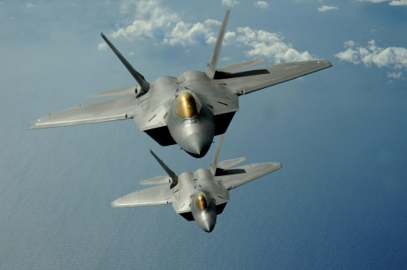
Council Meeting Objectives
1. Focus on activities that can support the chapters; to help them grow their membership
2. Share chapter successes and look for solutions to issues and concerns
3. Update the group on state and national legislative issues and support for active duty and veterans

Slide 6

Agenda June 16, 2018
Call to Order
Minutes, Treasurer ‘s Report
Meeting Goals
Action Review
Reporting Update
MOAA Leadership Workshop, Greenville, SC
Chapter Sharing
Chapter Leadership
VP Updates; Membership, Legislative, Communication
Web Site, E Newsletter
MOAA Update
Meeting Review
Next Meetings; 4th Qtr, 2019 schedule

Slide 7

Reports
MOAA
Council and Chapter Officer Form
Report a New Chapter Member $5 incentive for each qualifying member
Committee Module for Profile Chapter Roster $50 incentive
Council
Officer Roster when Changes Occur
Quarterly Report
Add meetings highlights; speaker recommendations, upcoming special meetings
Add recruiting process successes
Change to 2 times per year 31 Dec, 30 June, but can be submitted when a special event occurs
Chapters not opening Committee Module: NC-03 Eastern Carolina Chapter
NC-06 Sandhills Chapter
NC-14 Piedmont Chapter

Slide 8

MOAA Leadership Workshop Greenville, SC 7,8 September 2018
Leadership Workshop 7, 8 Sept Greenville, SC
 |  | President | Membership | Legislative
NC00 | NC Council
NC01 | Cape Fear
NC02 | Coastal
NC03 | Eastern
NC04 | Char-Metro
NC06 | Sandhills
NC07 | SENCLAND
NC08 | Tarheel
NC09 | Triangle
NC10 | Western
NC11 | Catawba Valley
NC14 | Piedmont
NC17 | First Flight
NC20 | Central
NC21 | Hi Country
NC22 | New River

Slide 9
Chapter Sharing
In your Regional Groups, discuss:
SUCCESSES What makes your chapter successful? What brings your members to meetings, what generates enthusiasm, what engages your members?
ISSUES What are the issues that your chapter struggles with? What are barriers to members enthusiasm and commitment?
ACTION What are you doing to mitigate/solve these issues? What is your strategy, tactics for improvement?
Be prepared to report back to Council Group in 20 minutes with a brief overview of the highlights of your discussions.

Slide 10

Regional Chapter Organization
Eastern
NC02 Coastal Carolina
NC03 Eastern Carolina
NC07 SENCLAND
NC17 First Flight
Sandhills
NC01 Cape Fear
NC06 Sandhills
NC09 Triangle
Piedmont
NC04 Charlotte Metrolina
NC08 Tar Heel Central
NC14 LA Osborne Piedmont
NC20 Central Carolina
Western
NC10 Western Carolina
NC11 Catawba Valley
NC21 High Country
NC22 New River

Slide 11
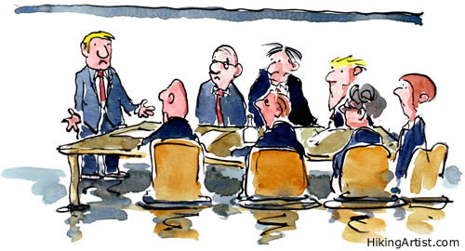
Chapter Organization by Membership
Small < 31
NC03 Eastern Carolina
NC14 LA Osborne Piedmont
NC22 New River
NC17 First Flight
Medium 40 to 62
NC02 Coastal Carolina
NC11 Catawba Valley
NC21 High Country
Large 64 to 84
NC04 Charlotte Metrolina
NC08 Tar Heel Central
NC09 Triangle
NC20 Central Carolina
Extra Large 150 to 231
NC01 Cape Fear
NC06 Sandhills
NC07 SENCLAND
NC10 Western Carolina

Slide 12
Best Practice Briefing
Leading a Chapter
D Lee

Slide 13

Upcoming Events
15, 16 June Council Meeting in Charlotte
7, 8 September Chapter Leaders Workshop, Greenville, SC
19, 20 October Council Meeting, Wilmington
1, 2 November MOAA Annual Meeting, Phoenix, AZ
Council Meetings 2019
Sandhills
Western (2Q19),
New River
Coastal (4th QTR Convention)

Slide 14

Col Marvin J. Harris Communications Awards
NC00 Council – 5 Star
E Newsletter
Council Web Site
NC01 Cape Fear – 5 Star
E Newsletter
Chapter Web Site
NC02 Coastal Carolina – 4 Star
Chapter Web Site
NC07 SENCLAND 5 Star
Print Newsletter
Chapter Web Site
NC09 Triangle 5 Star
Print Newsletter
Chapter Web Site
NC11 Catawba Valley 5 Star
Print Newsletter
Chapter Web Site
NC22 New River 5 Star
E Newsletter

Slide 15
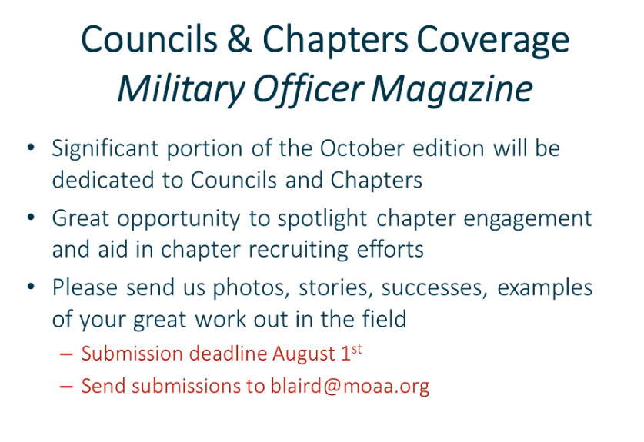

Slide 16

Speakers
Chapters overdue (> 4 years) for a visit from MOAA national:
NC-03 Eastern Carolina Chapter
NC-06 Sandhills Chapter
Veteran Suicide Prevention program
20 Vets die each day
Call VA Medical Center; Asheville, Salisbury, Durham, Fayetteville

Slide 17

Meeting Review
Did we meet our objectives?
1. Focus on activities that can support the chapters; to help them grow their membership
2. Share chapter successes and look for solutions to issues and concerns
3. Update the group on state and national legislative issues and support for active duty and veterans
Positive highlights
Areas for improvement
Actions Review

